Slide 1
Data Visualization and Analysis

Slide 2
Problem Statement
Analyse various school outcomes in Tennessee using pandas. Suppose you are a public school administrator. Some schools in your state of Tennessee are performing below average academically. Your superintendent, under pressure from frustrated parents and voters, approached you with the task of understanding why these schools are under-performing. To improve school performance, you need to learn more about these schools and their students, just as a business needs to understand its own strengths and weaknesses and its customers. Though you is eager to build an impressive explanatory model, you know the importance of conducting preliminary research to prevent possible pitfalls or blind spots. Thus, you engages in a thorough exploratory analysis, which includes: a lit review, data collection, descriptive and inferential statistics, and data visualization.

Slide 3
OBJECTIVE -
understanding why these schools are under-performing in Tennessee ?
To improve school performance, you need to learn more about these schools and their students.

Slide 4
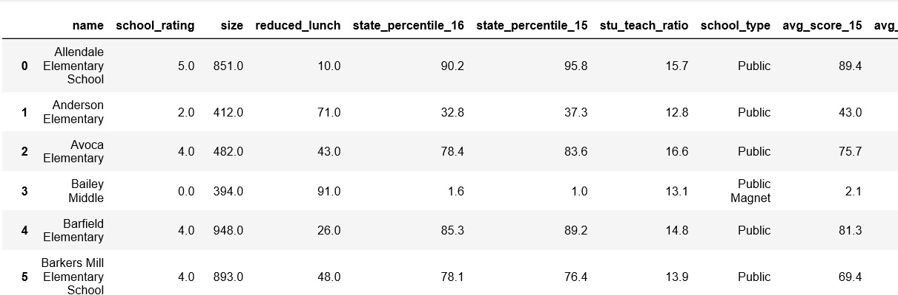
Phase 1
Given data

Slide 5
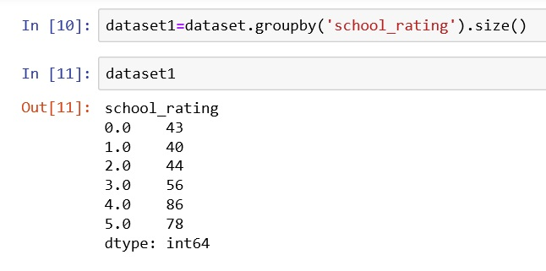
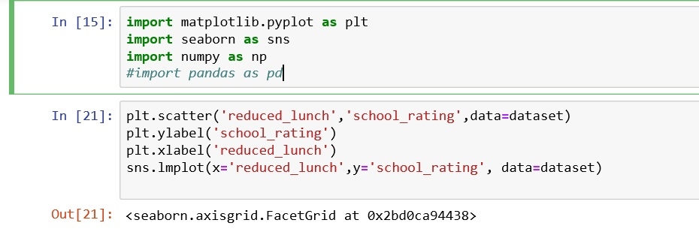
Group by the given data by school rating.
Phase 2
Importing required packages.

Slide 6

Correlation between school rating and reduce lunch.
Phase 3
A value of -1 indicates the strongest possible negative correlation, meaning as one variable decreases the other increases. And a value of 1 indicates the opposite.

Slide 7
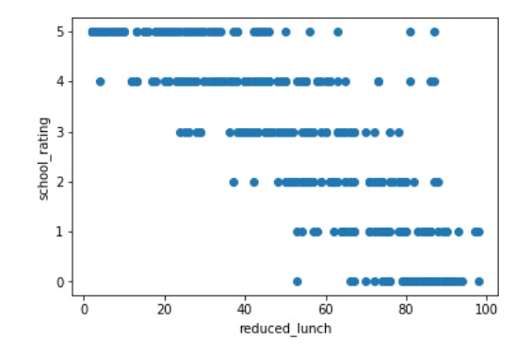
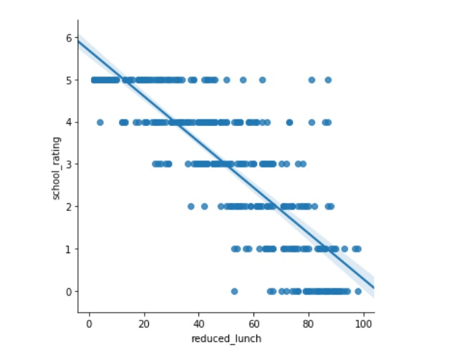
Scatter plot-
Phase 4

Slide 8
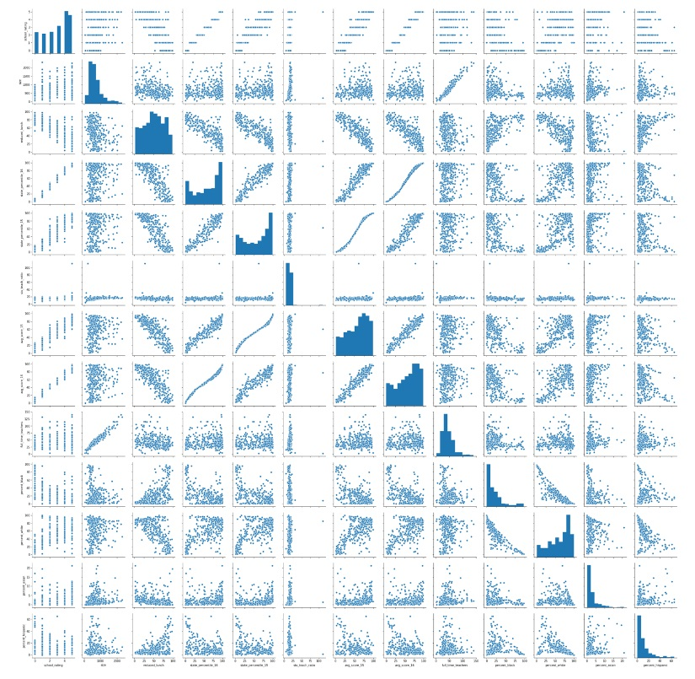
Pair plot-

Slide 9
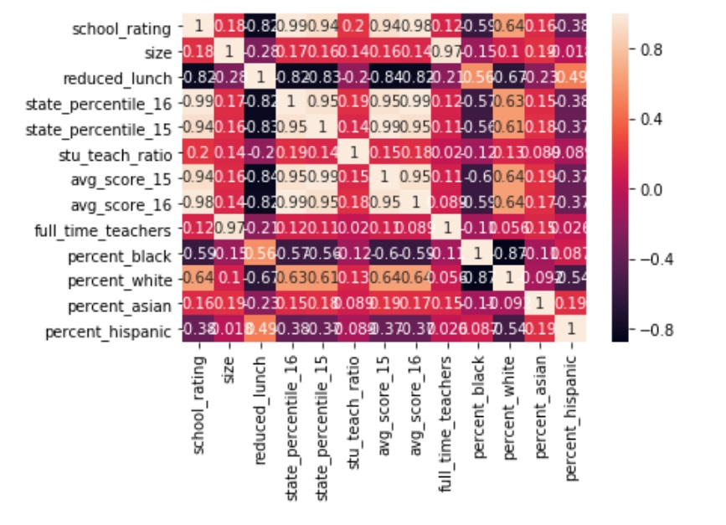
Heat Plot-

Slide 10
Result & Conclusion-
As per the above analysis we found that why the schools in our state are performing low in Tennessee.
Food served to the student are varying school to school, so those who serve less food, performing below average academically.
On the other hand school serve appropriate food, are perform good.

Slide 11
Thank You!

